Slide 2
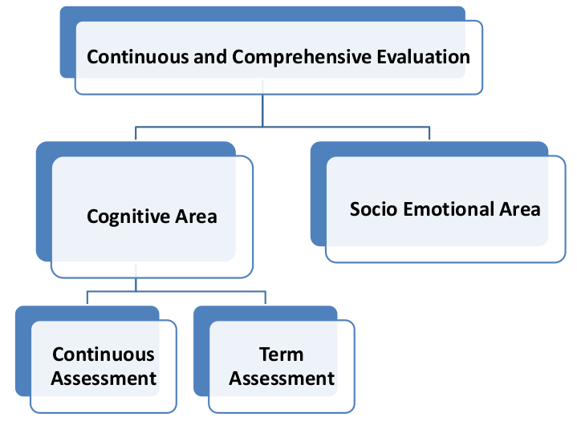

Slide 3

Communication skills
Interpersonal Skills
Empathy
Coping with emotions
Coping with stress
Problem solving Skills
Decision making
Critical Thinking
Creative Thinking Skills
Self awareness
Artistic
Social
Cultural
&
Vocational Proficiencies

Slide 4
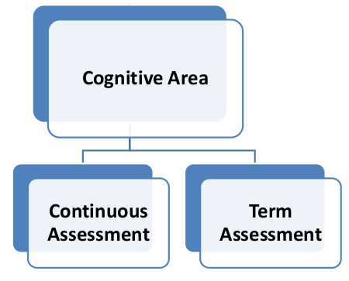
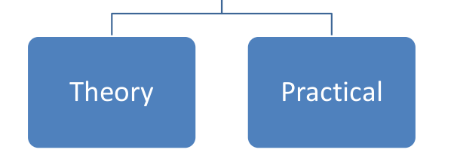

Slide 6
2020 HSE I Admission onwards
Continuous Evaluation
Unit Based Assessment
10 scores
10 scores
Dissertation പാഠാന്വേഷണ രേഖ

Slide 7








Unit Based Assessment
Oral Assessment
Written Test
Performance test
Open book assessment
Preparation of questions
Lab Activity
Creative work
Problem Solving
List Continues . . . . . . . . . .

Slide 8

Thesis
Dissertation
Project
Let’s Compare

Slide 9

A comprehensive document that is prepared after the completion of the research.
Full time process, degree is awarded on the basis of thesis
Thesis
Problem identification
Hypothesis
Methodology
Data collection
Analysis
Interpretation
Finding result

Slide 10

പാഠാന്വേഷണ രേഖ
Is done as the part of a course
Time bound
Awarding of degree is not based on dissertation alone

Slide 11

Solving a specific problem by applying an existing idea.

Slide 12
Objectives of Dissertation
Knowledge enquiry
Application
Research Aptitude
Data collection
Classification of data
Analysis of data
Concept Formation
Academic writing
Academic ethics

Slide 13

Selection of Topic

Slide 14
Implementation
To be implemented from HSE I students of 2020-21
The duration of dissertation is two academic years
Dissertation should be prepared for all subjects, individually
To be started on first term of first year
A general orientation on dissertation can be conducted for the students
Dissertation can be planned in the SRG
Submission of synopsis is to be done in the first year for evaluation.
From data collection to final submission is to be done in the second year.
Valuation must be done term wise
Details of software and monitoring will be intimated through separate circular by DGE

Slide 15
Format Of Synopsis
Title
Brief
Self explanatory
Introduction
Area
Time
Place
Relevance
Limitations
Objective of study
Aim and objective of the study
Review of literature
Previous knowledge required for preparing synopsis.
Action Plan
Methodology, strategies and tools
Name of the book, author, year
Bibliography
Persons, Teacher, Periodicals
URL (date)

Slide 16

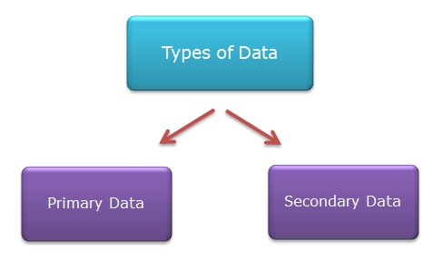
Data Collection
Collecting data with appropriate tools/methods
Observation
Survey
Interview
Questionnaire
Experiment
Case study

Slide 17
Data Analysis & Interpretation
Classification
Analysis
Interpretation

Slide 18
Findings & Suggestions
Findings
Suggestions

Slide 19
Conclusion and Scope of follow up
Personal interpretation in accordance with the objectives
Further areas of study

Slide 20
Bibliography
All sources used

Slide 21
Structure of Dissertation
Title
Certificates
Introduction
Body
Body
Conclusion and scope of follow up
Review of literature
Reference
Action plan
Appendix
Data presentation
Findings

Slide 22
DECLARATION
I hereby declare that this dissertation entitled .......................... (Name of the title of the study) has been submitted for the partial fulfilment for the award of Higher Secondary Certificate from the Department of General Education, Higher Secondary Wing, Government of Kerala in ............ (Month and Year) is my own work. To the best of my knowledge and belief, it is the result of my own effort and has not been submitted for the award of any certificate in any other institution.
Signature of the Student
Name : ..................
Register Number : ..................
Class : ..................
Name of School : ..................
Place: ..............
Date : ...............

Slide 23
CERTIFICATE
It is certified that (Name of the student) has carried out the work presented in this dissertation entitled ......................... (Name of the title of the study ) for the partial fulfilment for the award of Higher Secondary Certificate from the Department of General Education, Higher Secondary Wing, Government of Kerala in ............. (Month and Year). It is further certified that the work in this dissertation is the result of the candidate’s own effort and has not been submitted for the award of any certificate in any other institution. This work has been carried out during the current academic year.
Register Number of the Candidate : ..........................
Signature of Teacher in Charge (Guide)
Name
Designation
Place : .................. Signature of Principal
Date : ...................
(School Seal)

